Slide 1
项目概览
Celeste final report
霍君安 龚思嘉 周宇哲
核心函数
面向对象编程OOP

Slide 2
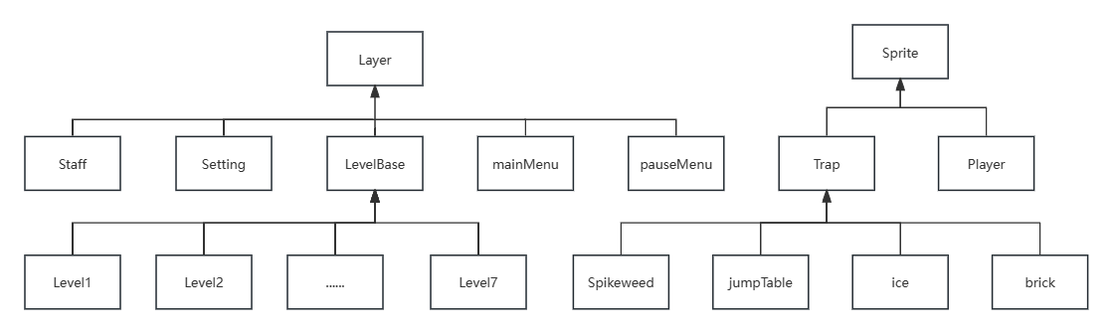
Class diagram UML

Slide 3
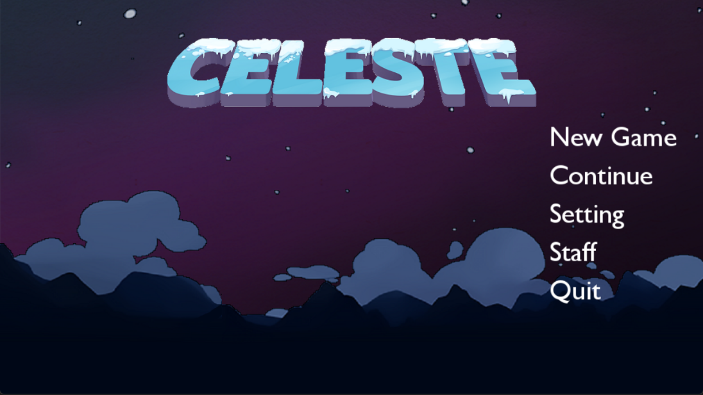
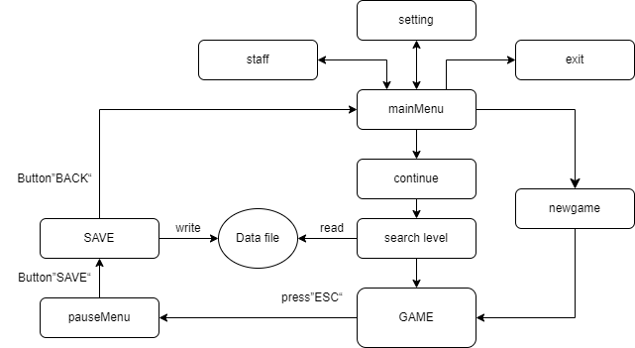
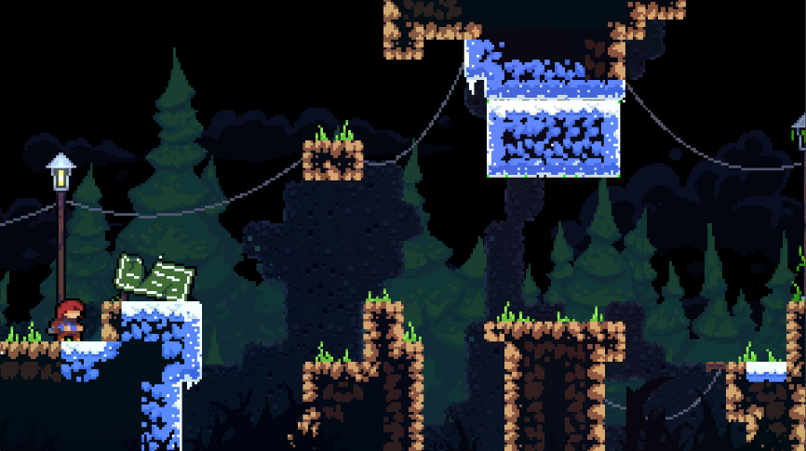
Game flowchart
Main scene
Game scene

Slide 4
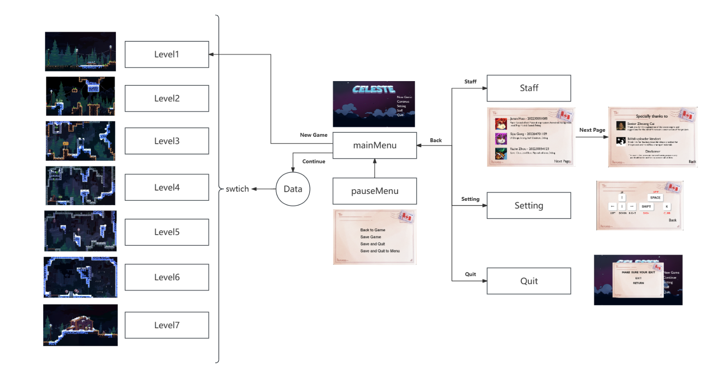
Flow chat

Slide 5
项目概览
核心函数
核心函数
面向对象编程OOP

Slide 6




组成部分
Scene
Level
Trap
Player
1
2
3
4
Main Menu Scene and Other Scene
Level Base
Level
End layer
Four kinds
of traps
Only important functions

Slide 8
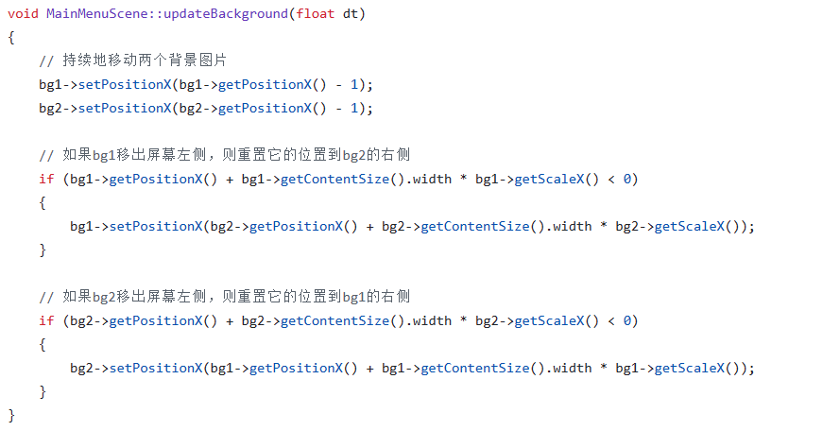



Main Menu Scene

Slide 9


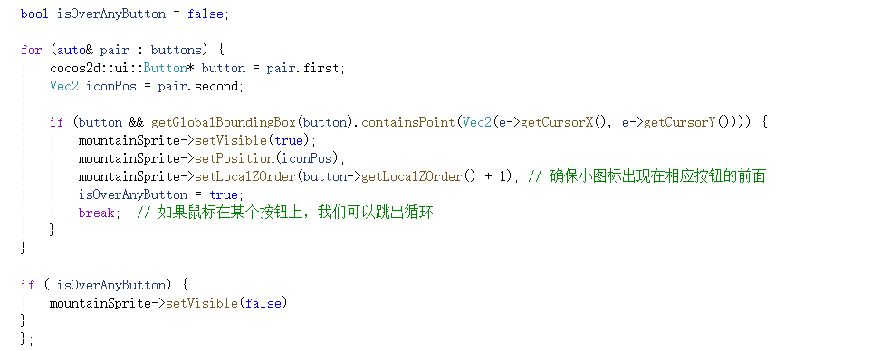
Main Menu Scene

Slide 10

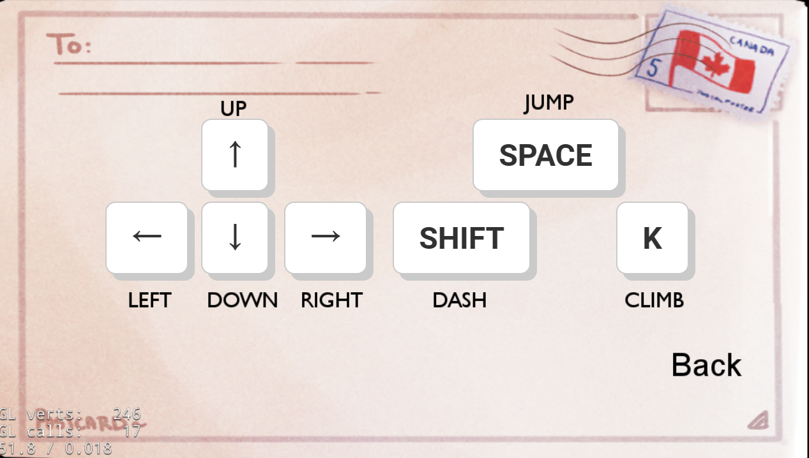






Setting

Slide 11




Staff

Slide 12
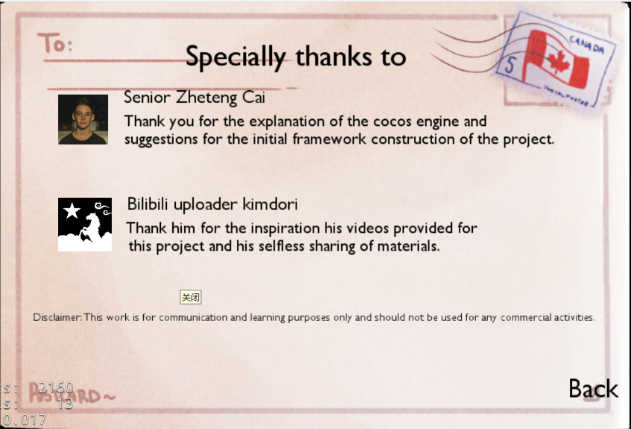


Staff

Slide 13
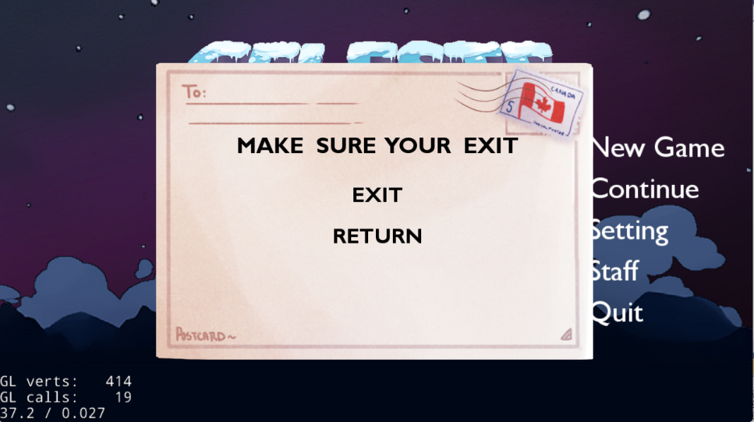
Quit

Slide 14
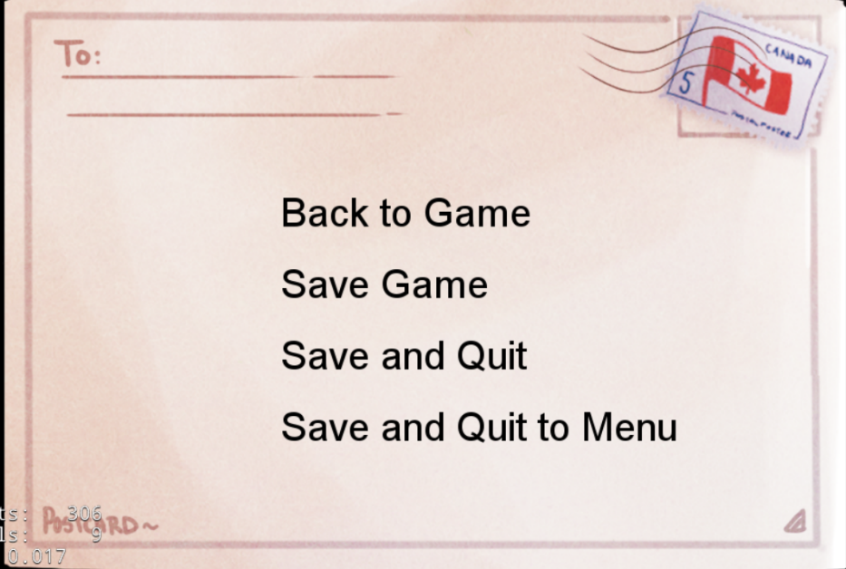
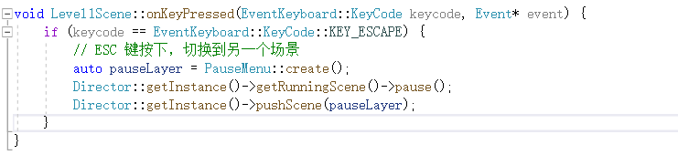
Pause Menu

Slide 15
Pause Menu

Slide 16
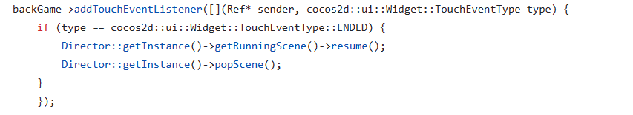
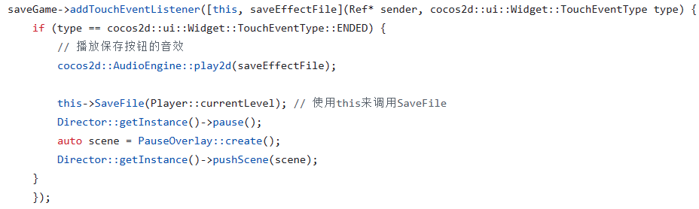
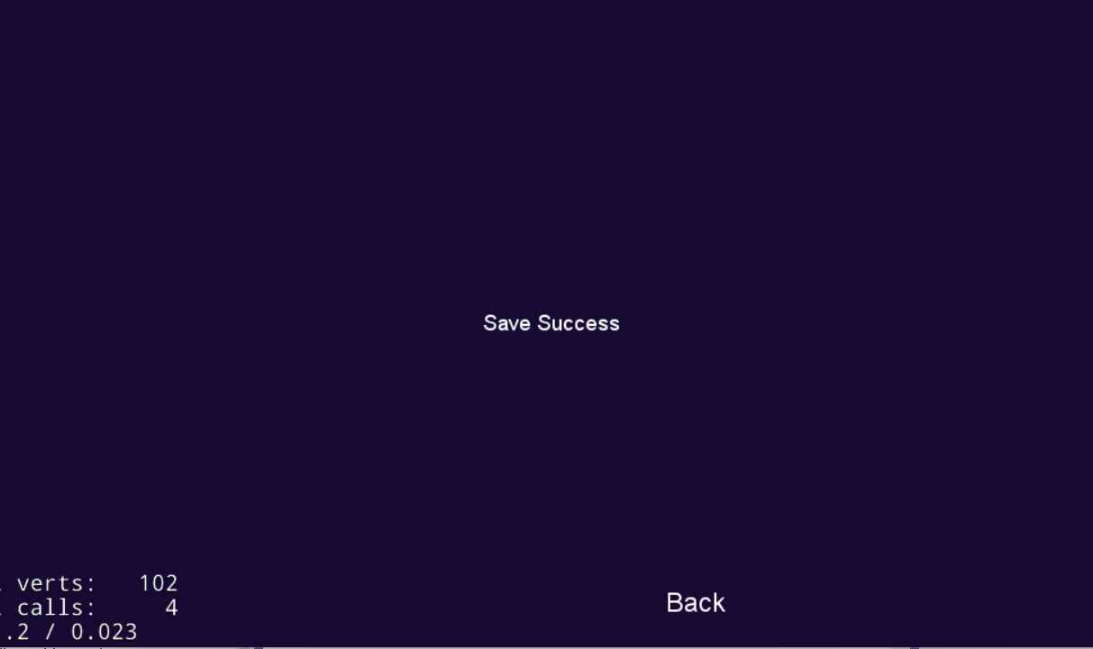
Pause Menu(data save)

Slide 17
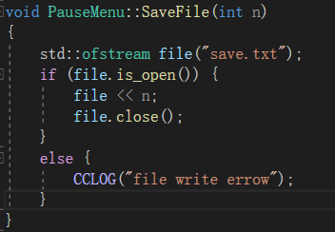
Pause Menu(data save)

Slide 18
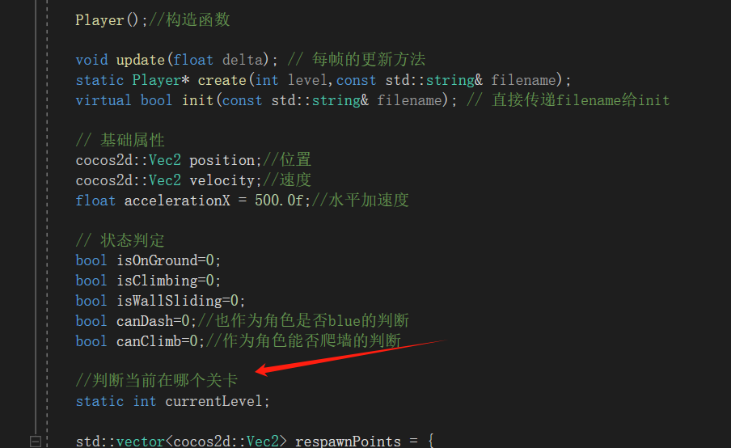
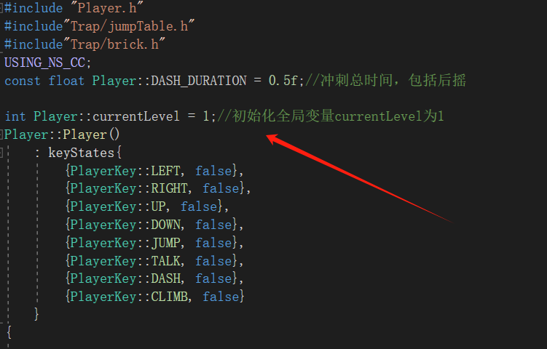
Pause Menu(data save)

Slide 19
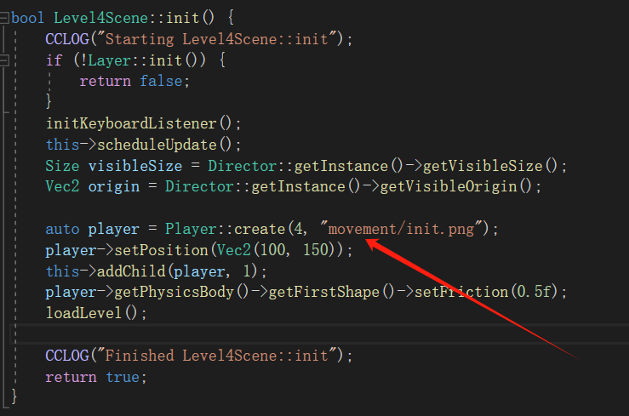
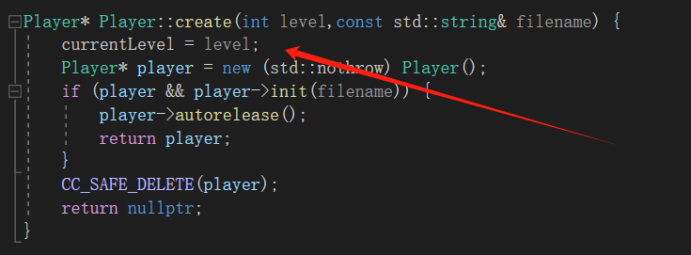
Pause Menu(data save)

Slide 20
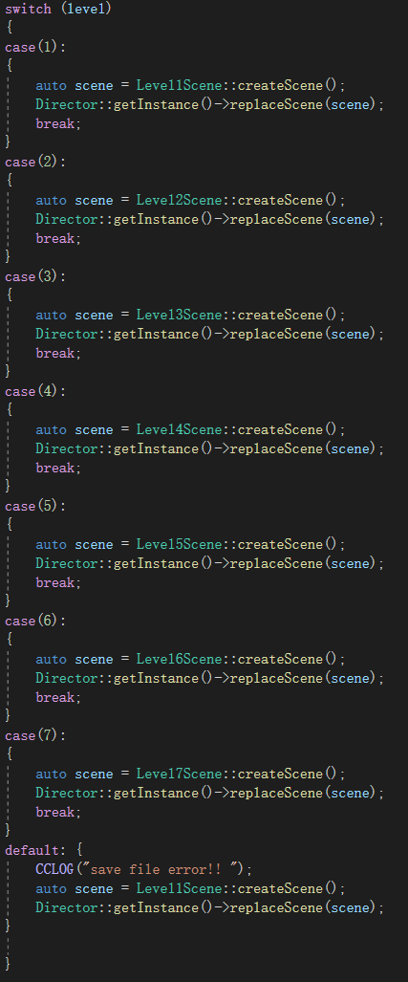
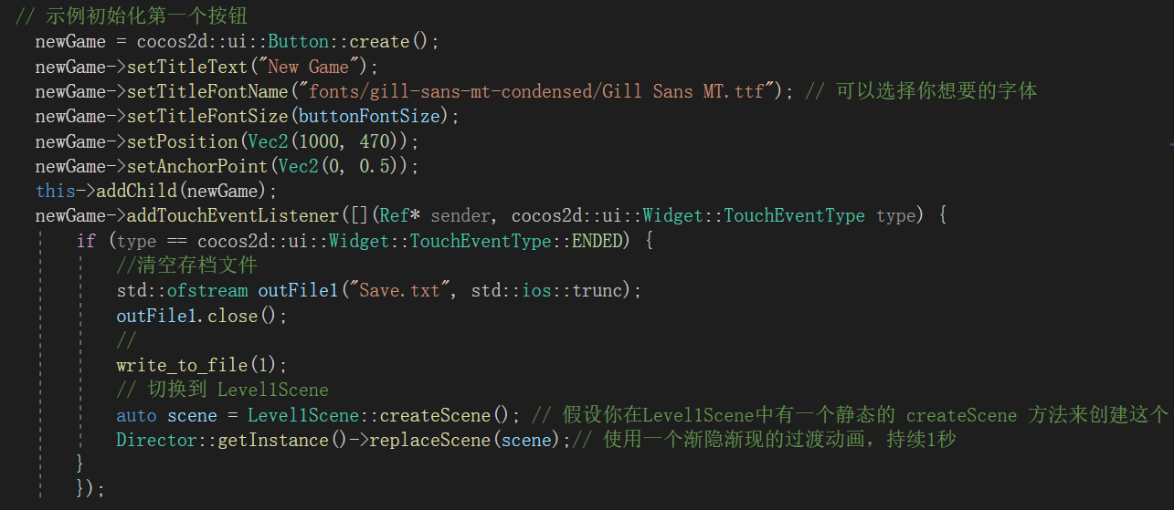
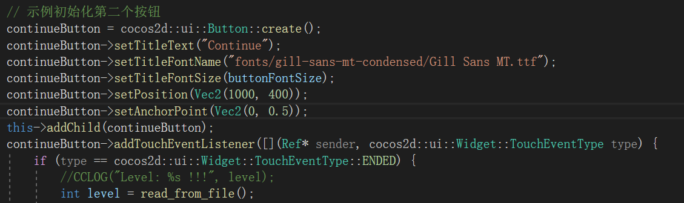
New game continue (Data read)

Slide 21
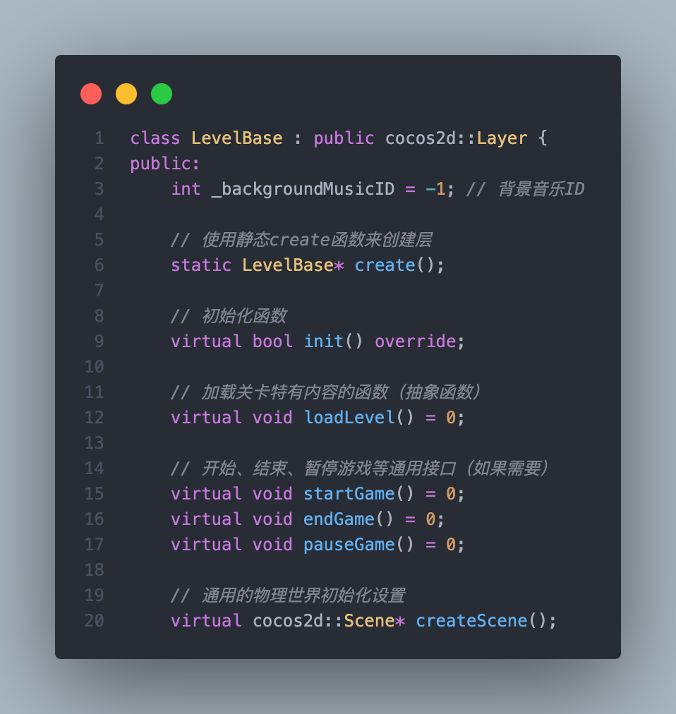
LevelBase Class

Slide 22
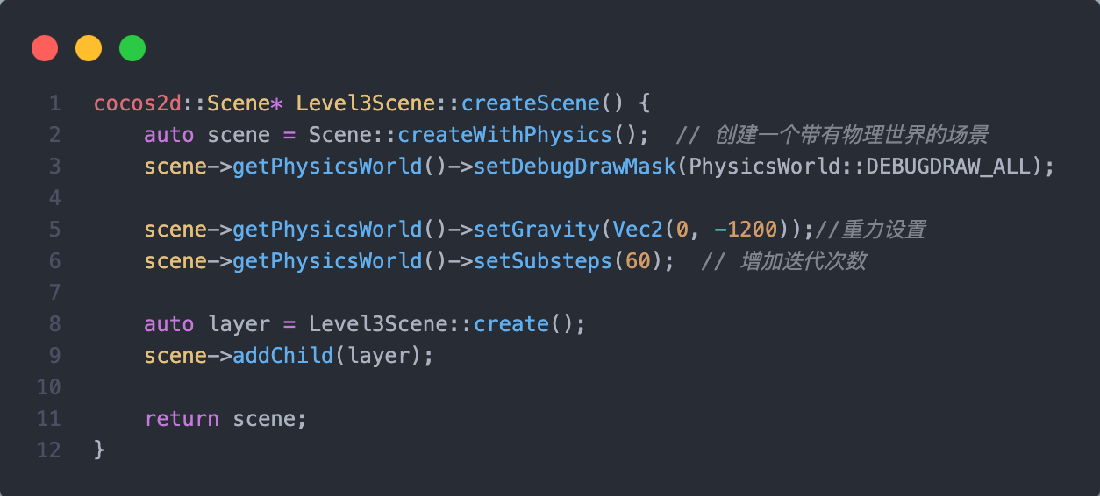
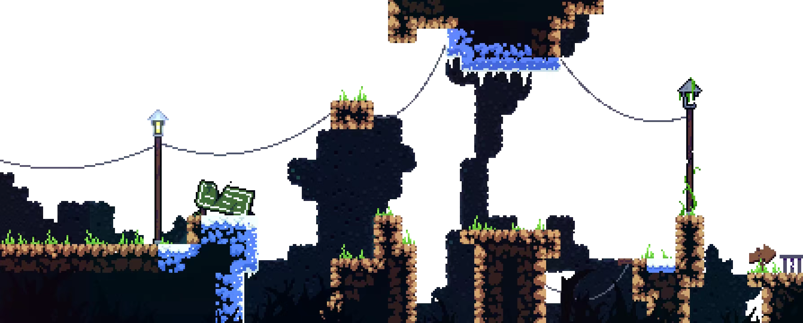
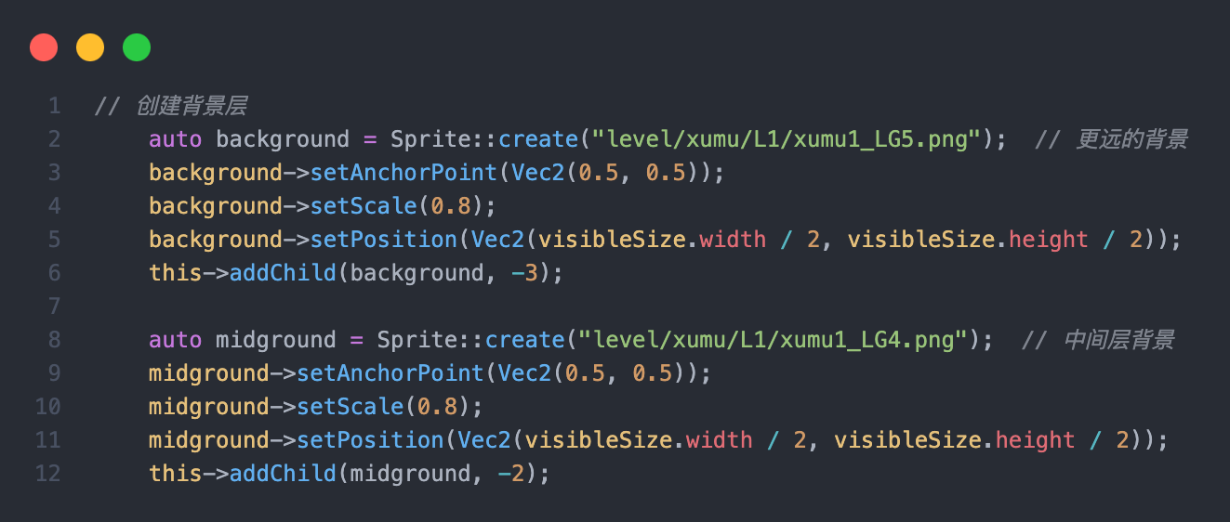
Level Class

Slide 23
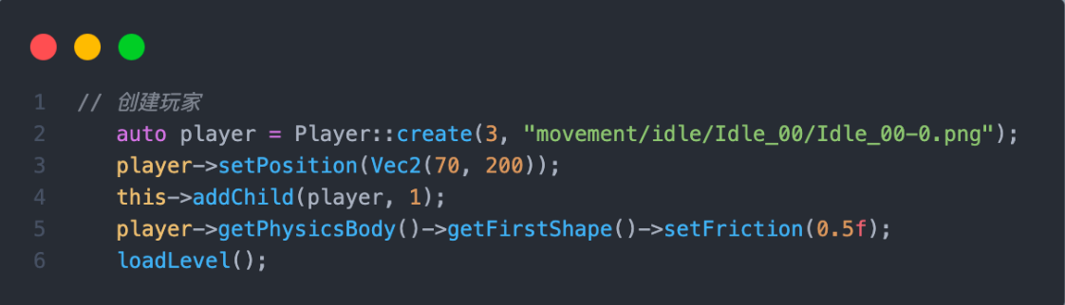

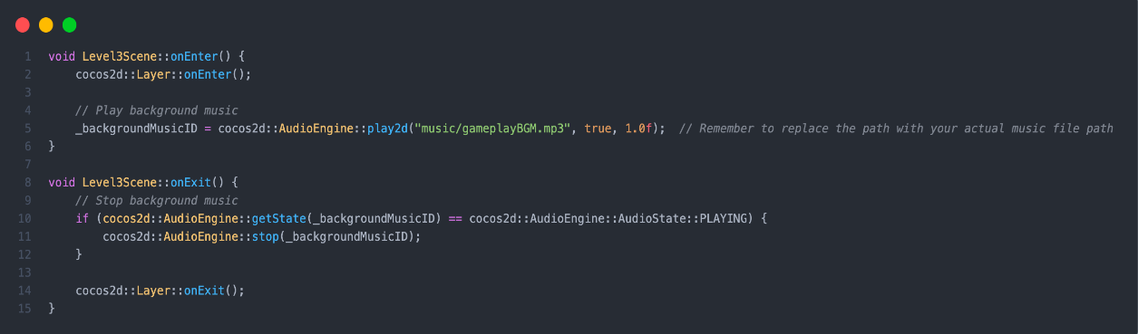
Level Class

Slide 24
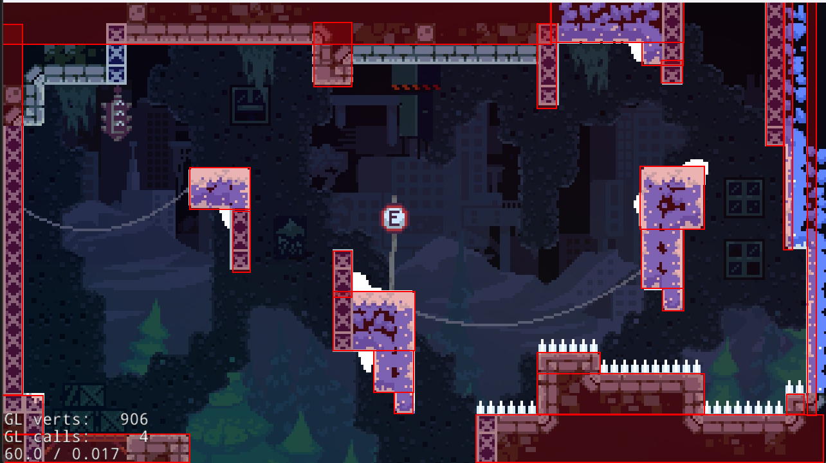
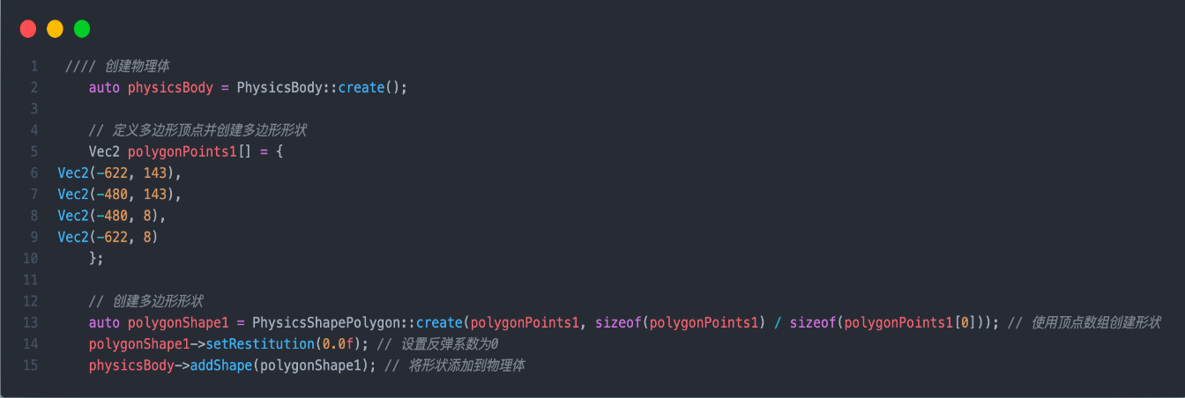
Level Class

Slide 25
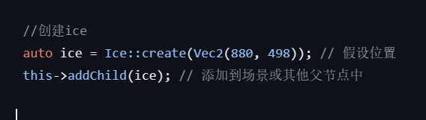

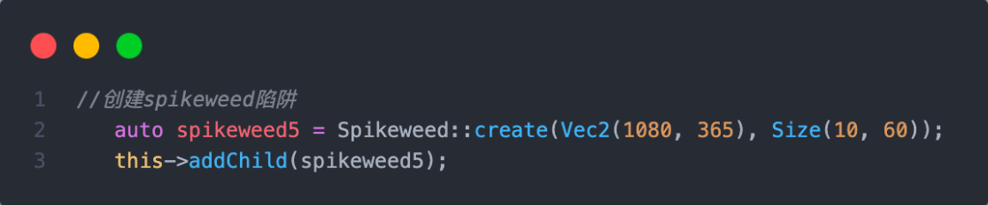

Level Class

Slide 26
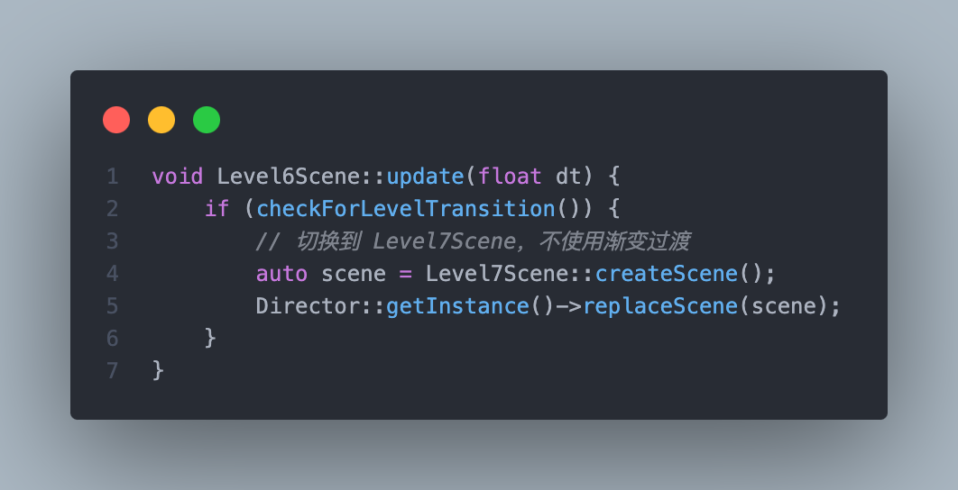
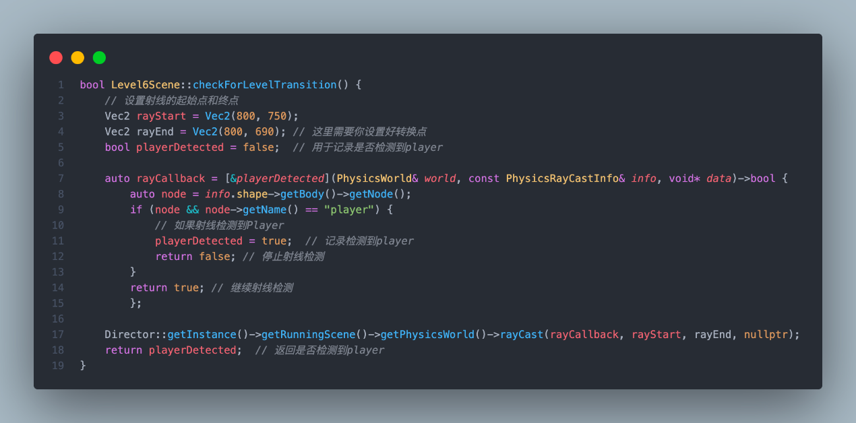
Level Class

Slide 27
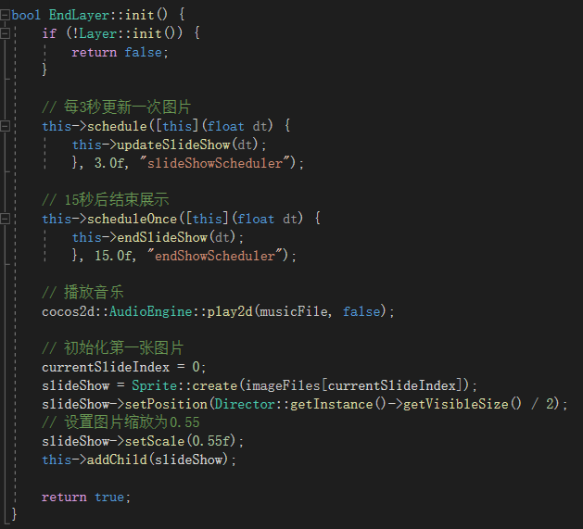
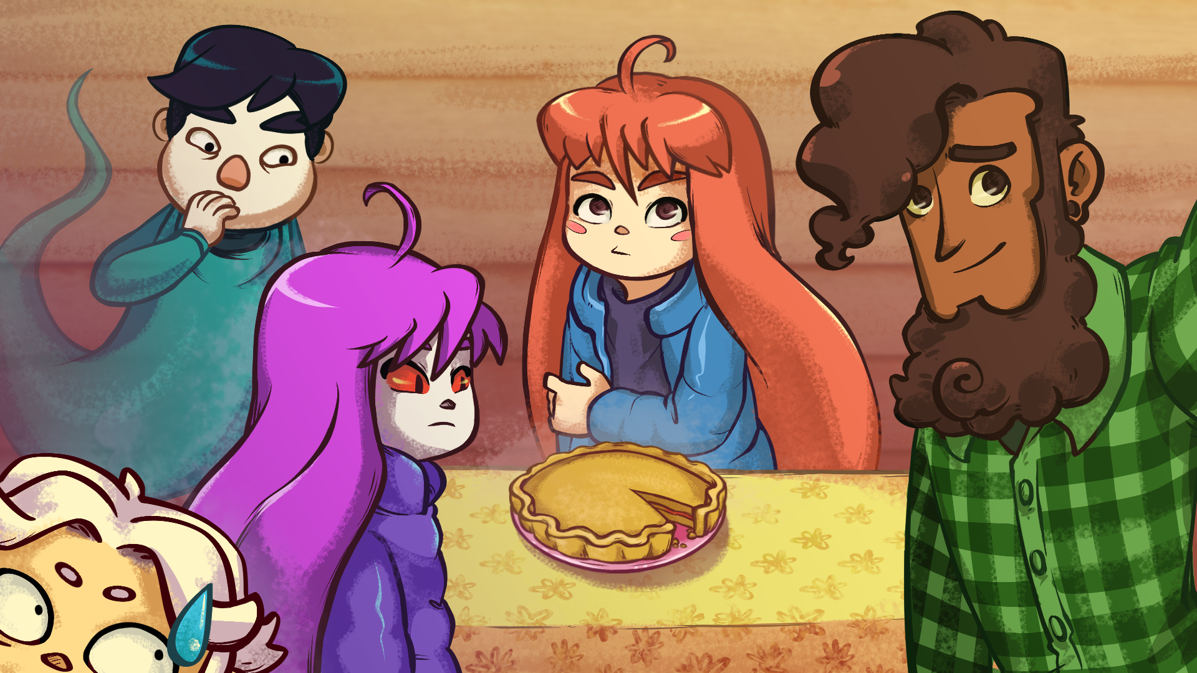
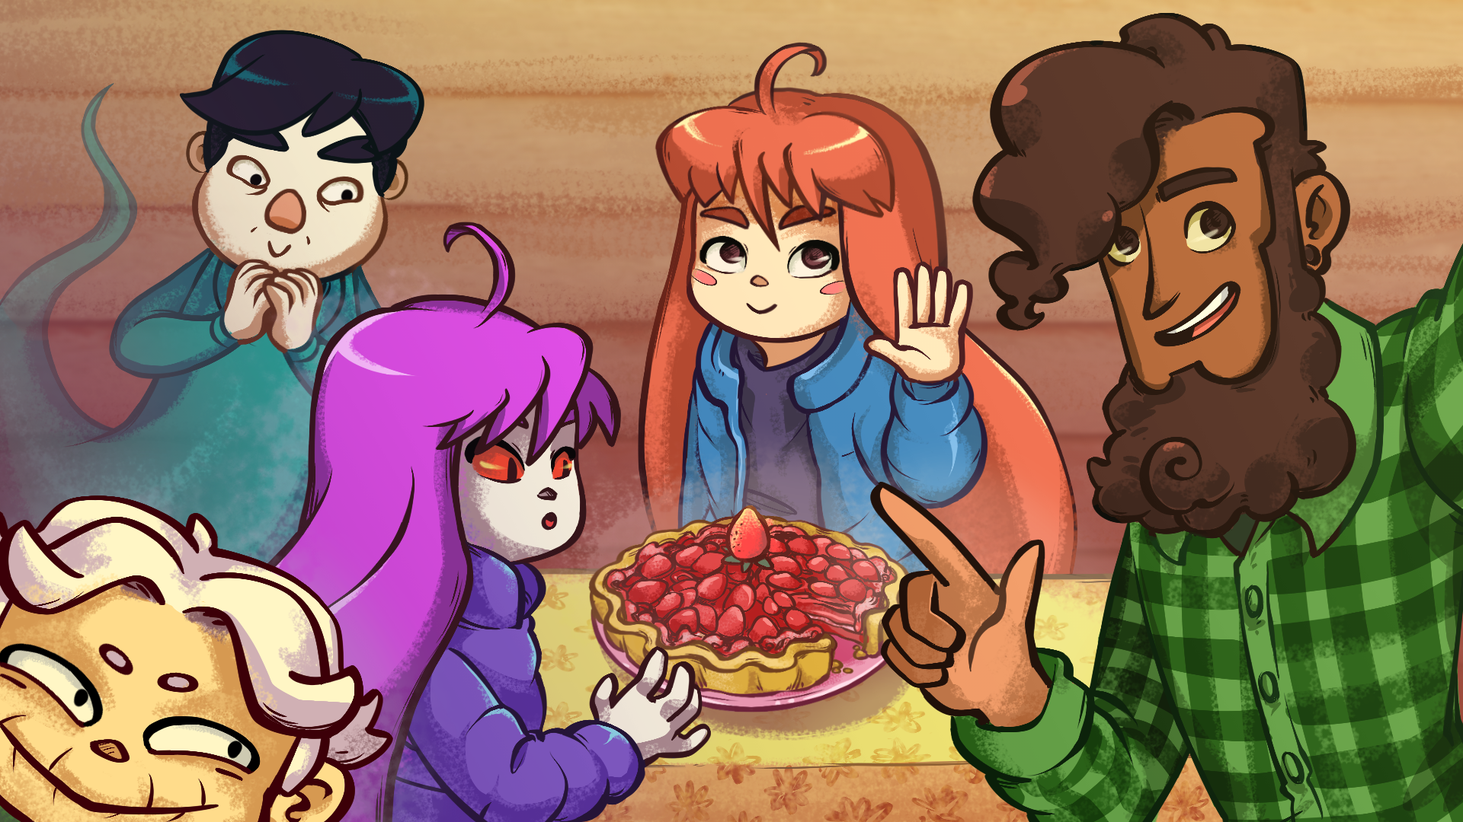



EndLayer Class

Slide 28
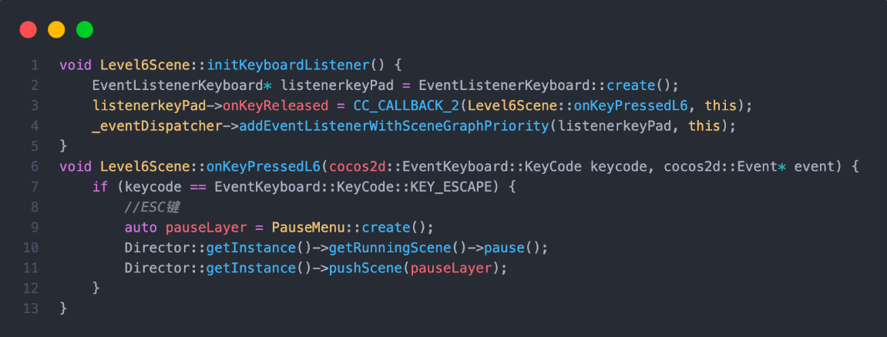
Pause Menu Scene in Level

Slide 29
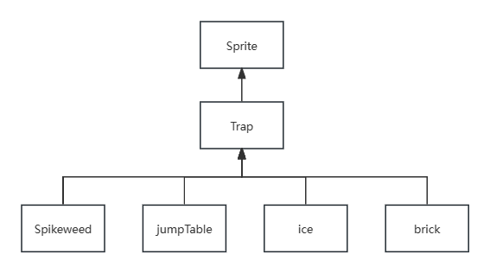
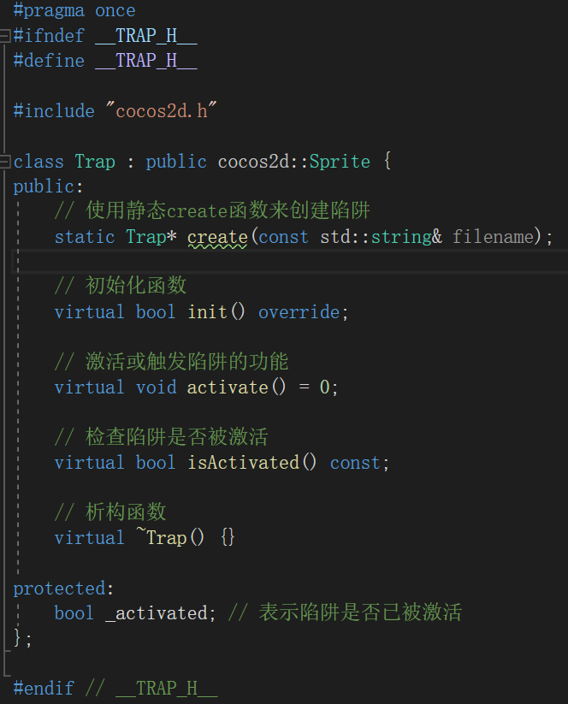
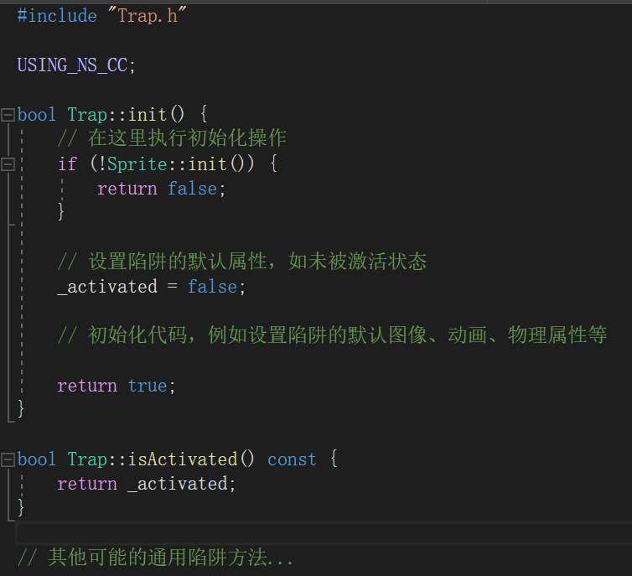
Trap class

Slide 30
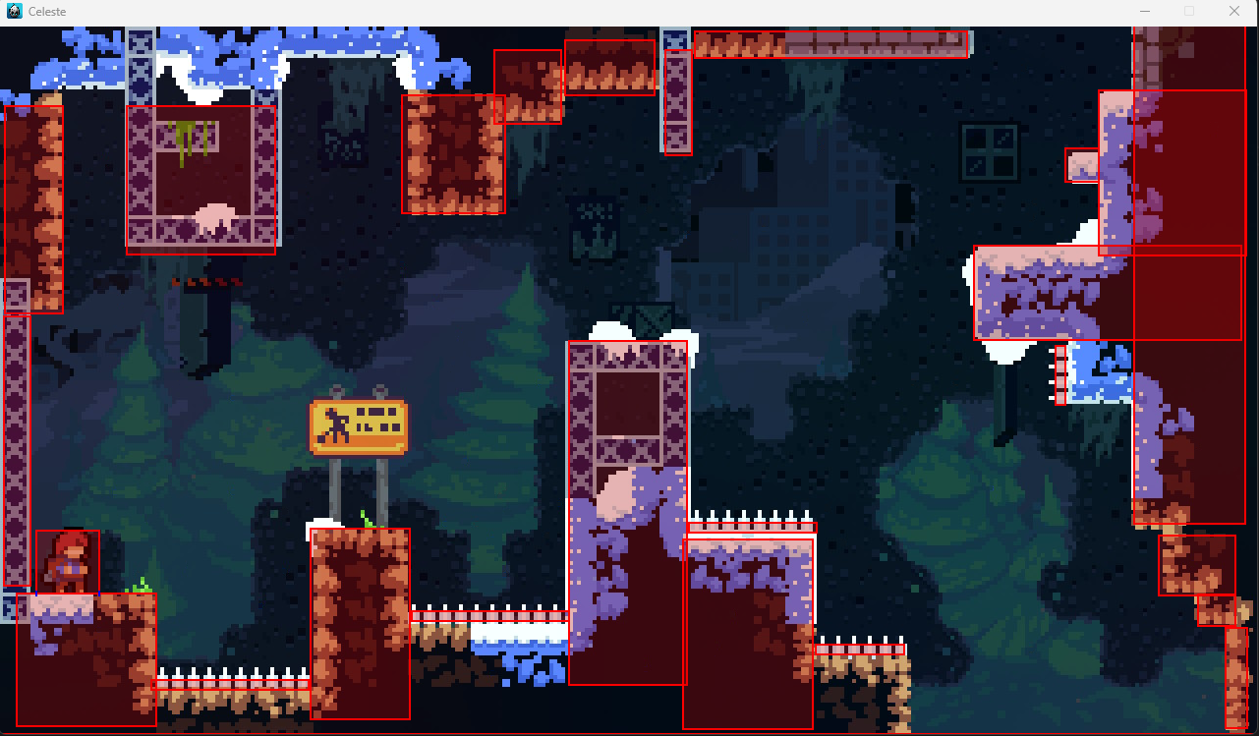
Spikeweed Class

Slide 31
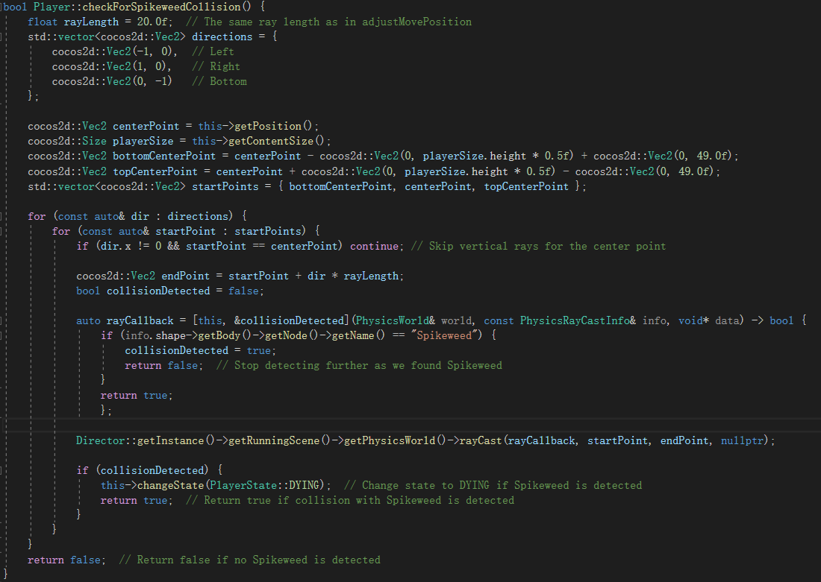
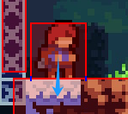
Spikeweed Class

Slide 32

ice Class

Slide 33
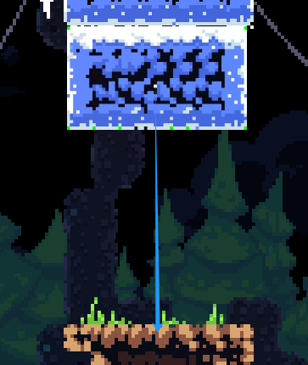
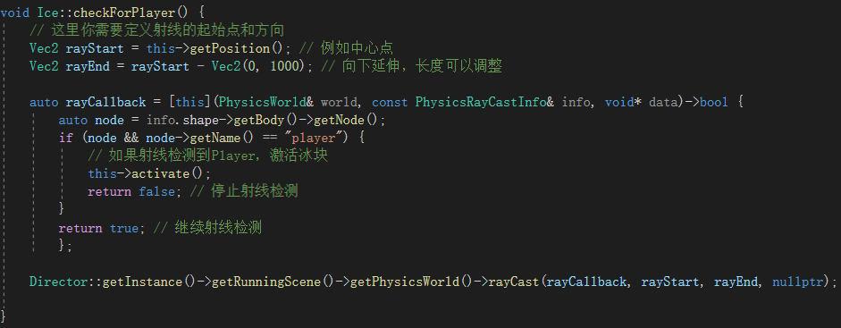
ice Class

Slide 34
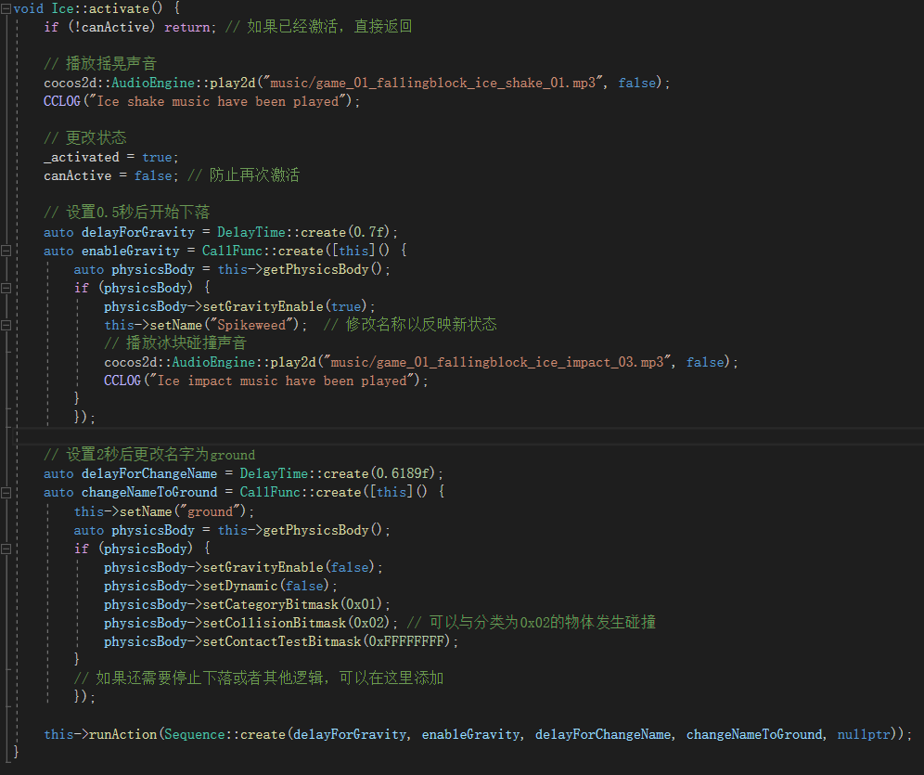
ice Class

Slide 35
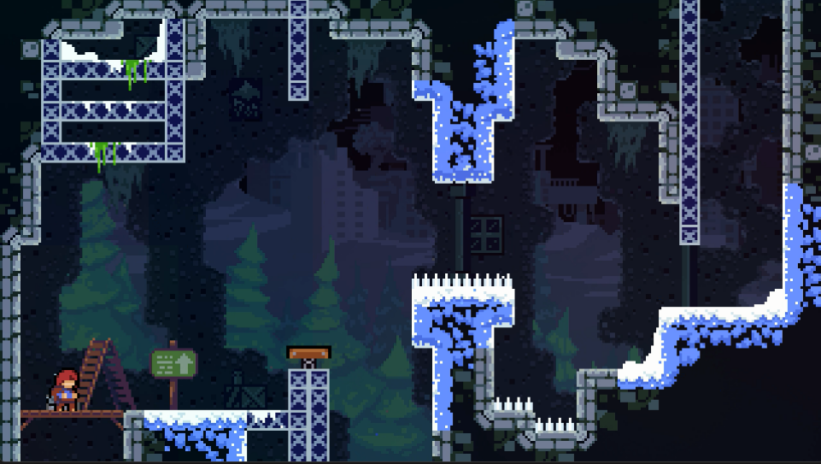
jumpTable Class

Slide 36
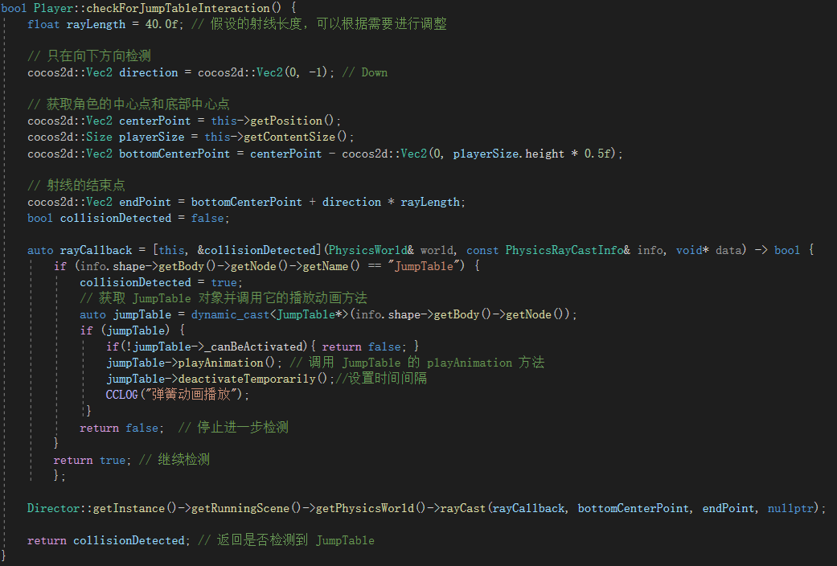

jumpTable Class

Slide 37


brick Class

Slide 38

brick Class

Slide 39


brick Class

Slide 40



Player Class (Keyboard Monitoring)

Slide 41


Player Class (Keyboard Monitoring)

Slide 42

Player Class(State Machine)

Slide 43



Player Class (State Machine)

Slide 44


Player Class(Animation System)

Slide 45


Player Class(Audio System)

Slide 46


isOnSolidGround()

Slide 47

adjustMovePosition ()

Slide 48

update()

Slide 49


Slide 50


Slide 51
项目概览
面向对象编程OOP
核心函数
面向对象编程OOP

Slide 52


OOP

Slide 54
项目概览
Special Thanks:
Senior Cai Zhengte, for his explanation of the Cocos engine and advice on the initial framework setup of the project.
Bilibili UP, kimdor, for the inspiration his videos provided for this project and his selfless sharing of materials.
Disclaimer:
This work is for exchange and learning purposes only and should not be used for any commercial activities.
核心函数
面向对象编程OOP

